Slide 1
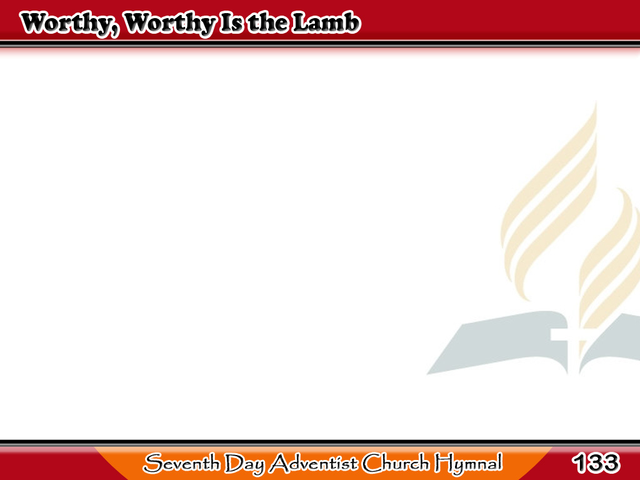
Sadyang Karapat-dapat ang Korderong Pinatay
Worthy, worthy is the Lamb,
Worthy, worthy is the Lamb;
Worthy, worthy is the Lamb
That was slain.
1/3

Slide 2
Sadyang Karapat-dapat ang Korderong Pinatay
-Refrain-
Glory, hallelujah!
Praise Him, hallelujah!
Glory, hallelujah to the Lamb!
1/3

Slide 3
Sadyang Karapat-dapat ang Korderong Pinatay
Savior, let Thy kingdom come!
Now the power of sin consume;
Bring Thy blest millennium,
Holy Lamb.
2/3

Slide 4
Sadyang Karapat-dapat ang Korderong Pinatay
-Refrain-
Glory, hallelujah!
Praise Him, hallelujah!
Glory, hallelujah to the Lamb!
2/3

Slide 5
Sadyang Karapat-dapat ang Korderong Pinatay
Thus may we each moment feel,
Love Him, serve Him,
praise Him still,
‘Til we all on Zion’s hill
See the Lamb.
3/3

Slide 6
Sadyang Karapat-dapat ang Korderong Pinatay
-Refrain-
Glory, hallelujah!
Praise Him, hallelujah!
Glory, hallelujah to the Lamb!
3/3

